Slide 1
The Harlem Renaissance
Music in Harlem

Slide 2
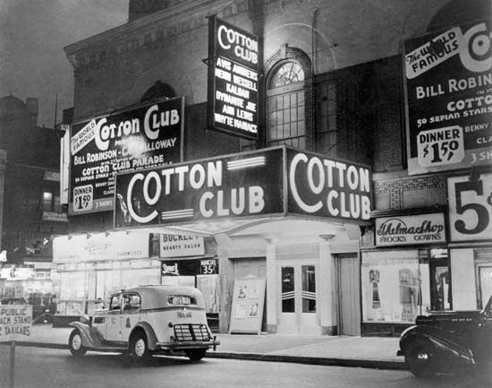

Slide 3
Musicians of the Harlem Renaissance
Louis Armstrong
Ella Fitzgerald
Duke Ellington
Billie Holiday
Charlie Parker
Chick Webb
Cab Calloway

Slide 4
Louis Armstrong

Slide 5
Louis Armstrong
Louis Satchmo Armstrong (August 4, 1901 – July 6, 1971), nicknamed Satchmo or Pops, was an American trumpeter, composer, singer and occasional actor who was one of the most influential figures in jazz. His career spanned five decades, from the 1920s to the 1960s, and different eras in jazz.

Slide 6
Famous Songs
What a Wonderful World
When The Saints Go Marching In
Dream a Little Dream of Me
Ain't Misbehavin
Stompin' at the Savoy

Slide 7
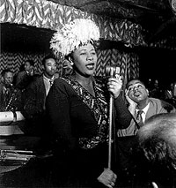
Ella Fitzgerald

Slide 8
Ella
Ella Jane Fitzgerald (April 25, 1917 – June 15, 1996) was an American jazz singer often referred to as the First Lady of Song, Queen of Jazz and Lady Ella. She was noted for her purity of tone, impeccable diction, phrasing and intonation, and a "horn-like" improvisational ability, particularly in her scat singing.

Slide 9
Ella’s Famous Songs
A-Tisket, A-Tasket
Dream a Little Dream of Me
It Don't Mean a Thing (If It Ain't Got That Swing)

Slide 10
Ella and Louis Armstrong
Summertime

Slide 11
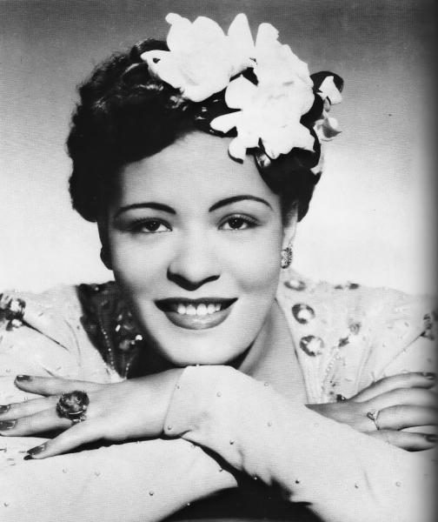
Billie Holiday

Slide 12
Billie Holiday
Eleanora Fagan (April 7, 1915 – July 17, 1959), professionally known as Billie Holiday, was an American jazz musician and singer-songwriter with a career spanning nearly thirty years. Nicknamed "Lady Day" , Her vocal style, strongly inspired by jazz instrumentalists, pioneered a new way of manipulating phrasing and tempo. There were other jazz singers with equal talent, but Holiday had a voice that captured the attention of her audience.

Slide 13
Billie Holiday Songs
All Of Me
God Bless the Child
I’ll Be Seeing You
Strange Fruit

Slide 14
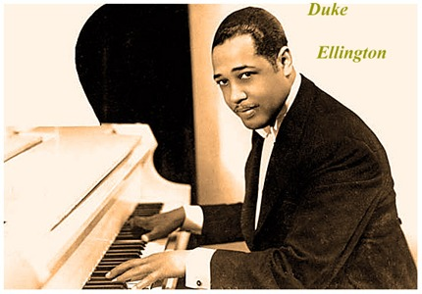
Duke Ellington

Slide 15
Edward Kennedy "Duke" Ellington (April 29, 1899 – May 24, 1974) was an American composer, pianist, and bandleader of a jazz orchestra, which he led from 1923 until his death in 1974 (a career spanning over fifty years.)

Slide 16
Duke Ellington Songs
Take the “A” Train
It Don’t Mean A Thing (If it ain’t got that swing)
Don’t Get Around Much Anymore

Slide 17
Charley Parker

Slide 18
Charley Parker
Charles "Charlie" Parker, Jr. (August 29, 1920 – March 12, 1955), also known as Yardbird and Bird, was an American jazz saxophonist and composer. Parker was a highly influential jazz soloist and a leading figure in the development of bebop; a form of jazz characterized by fast tempos, virtuosic technique and advanced harmonies.

Slide 19
Charley Parker Songs
Night in Tunisia
Bird of Paradise
Hot House

Slide 20
Chick Webb

Slide 21
Chick Webb
William Henry "Chick" Webb (February 10, 1905 – June 16, 1939) was an American jazz and swing music drummer as well as a band leader. From an early age, he suffered from tuberculosis of the spine , leaving him with short stature and a badly deformed spine which caused him to appear hunchbacked. The idea of playing an instrument was suggested by his doctor to "loosen up" his bones. He supported himself as a newspaper boy to save enough money to buy drums, he first played professionally at age 11. At the age of 17 he moved to New York City and by 1926 (age 21) was leading his own band in Harlem. He alternated between band tours and residencies at New York City clubs through the late 1920s. In 1931, his band became the house band at the Savoy Ballroom. He became one of the best-regarded bandleaders and drummers of the new "swing" style.

Slide 22
Chick Webb Known For
Stompin’ at The Savoy
Midnight in a Madhouse

Slide 23
Cab Calloway

Slide 24
Cab Calloway
Cabell Calloway III (December 25, 1907 – November 18, 1994) was an American jazz singer, dancer and bandleader. He was strongly associated with the Cotton Club in Harlem, New York City, where he was a regular performer. Calloway was a master of energetic scat singing and led one of the United States' most popular big bands from the start of the 1930s to the late 1940s. He danced in movies, in one movie, he can be seen performing a gliding back step dance move, which some observers have described as the precursor to Michael Jackson's "moonwalk".

Slide 25
Cab Calloway Songs
Minnie The Mooch
Jumpin’ Jive

Slide 26
The End

Slide 27
More Musicians
Dizzy Gillespie-Trumpet player
Count Basie-Piano and Band Leader
Thelonious Monk-Singer and Pianist
Fats Waller-Pianist and Singer

Slide 28
Dizzy Gillespie

Slide 29
Count Basie

Slide 30
Thelonius Monk

Slide 31
Fats Waller

