Slide 1

Champion Middle School
Health Science Academy

Slide 2
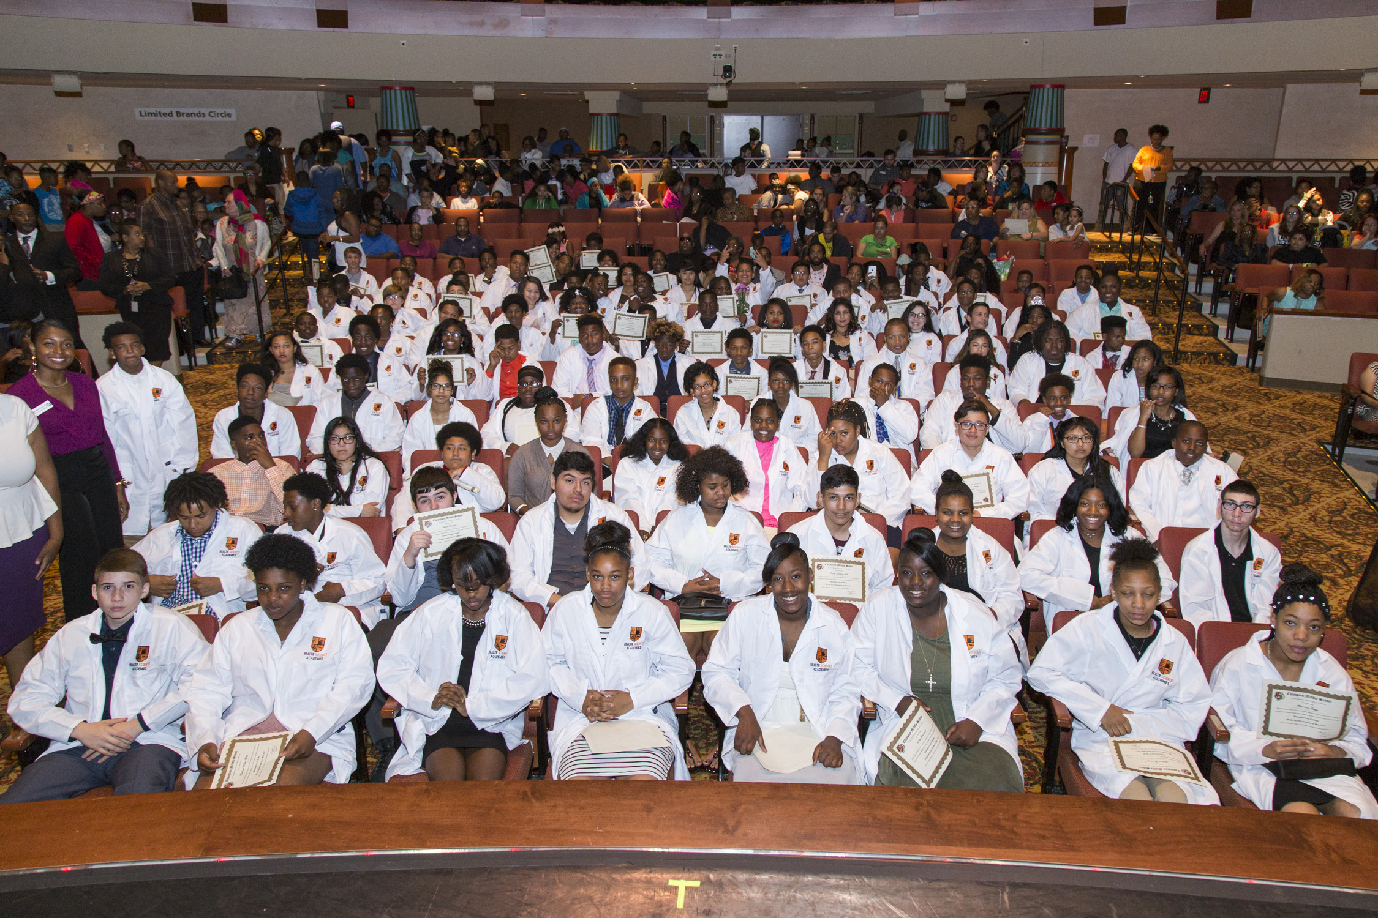
Champion Health Science Academy Highlights

Slide 3

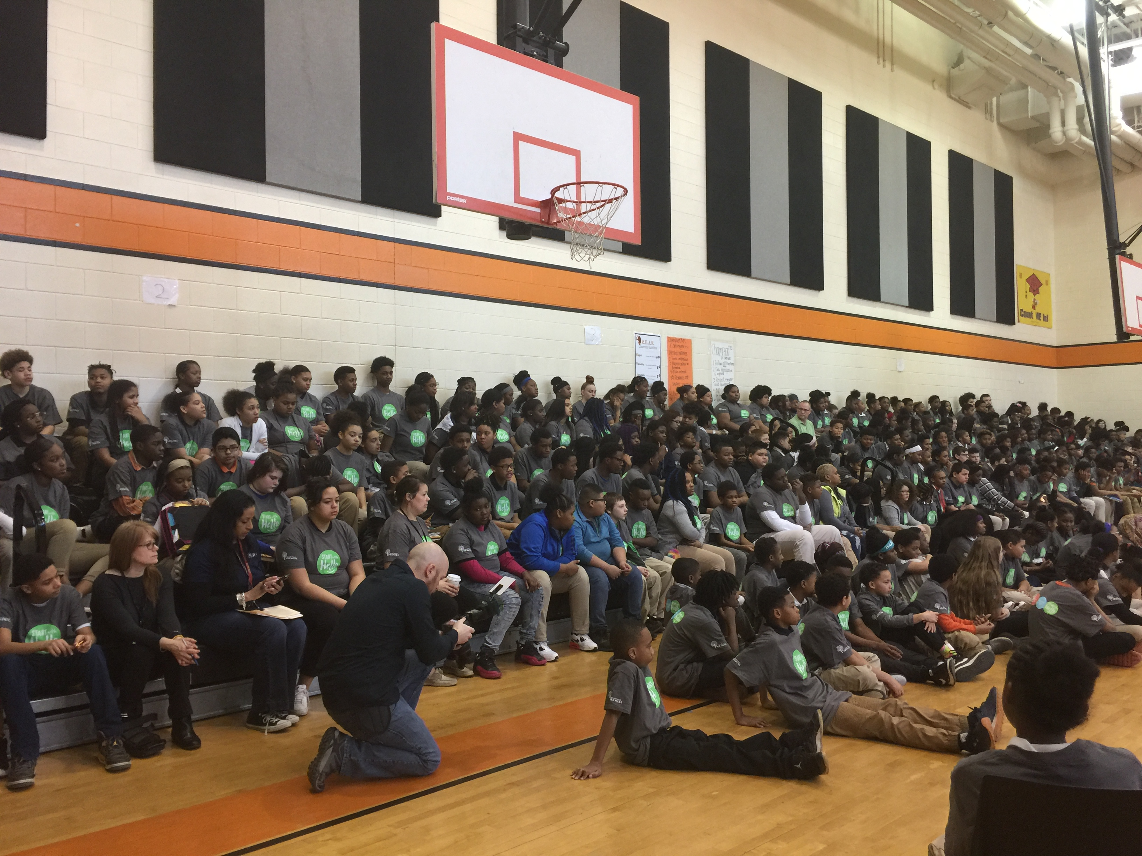
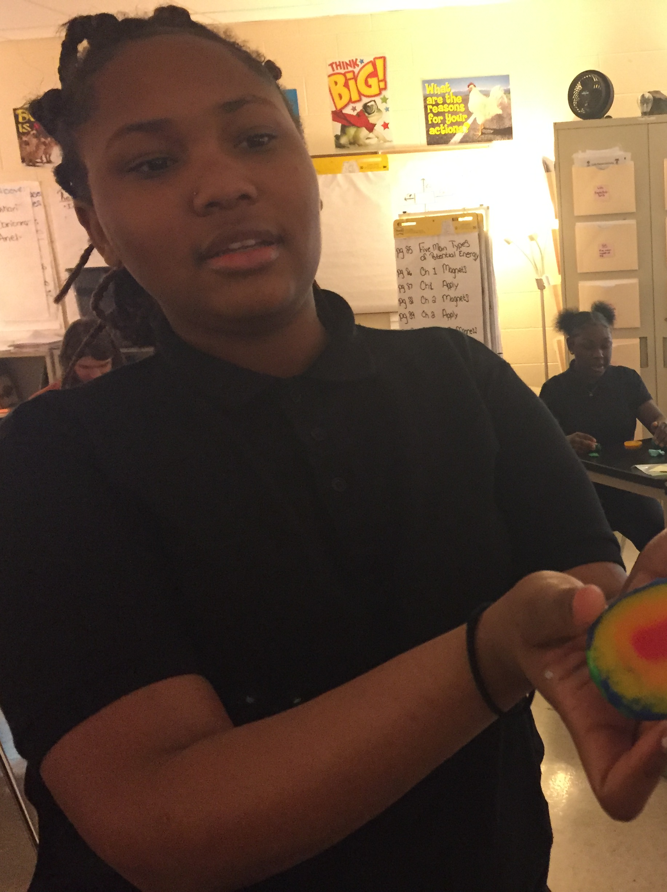
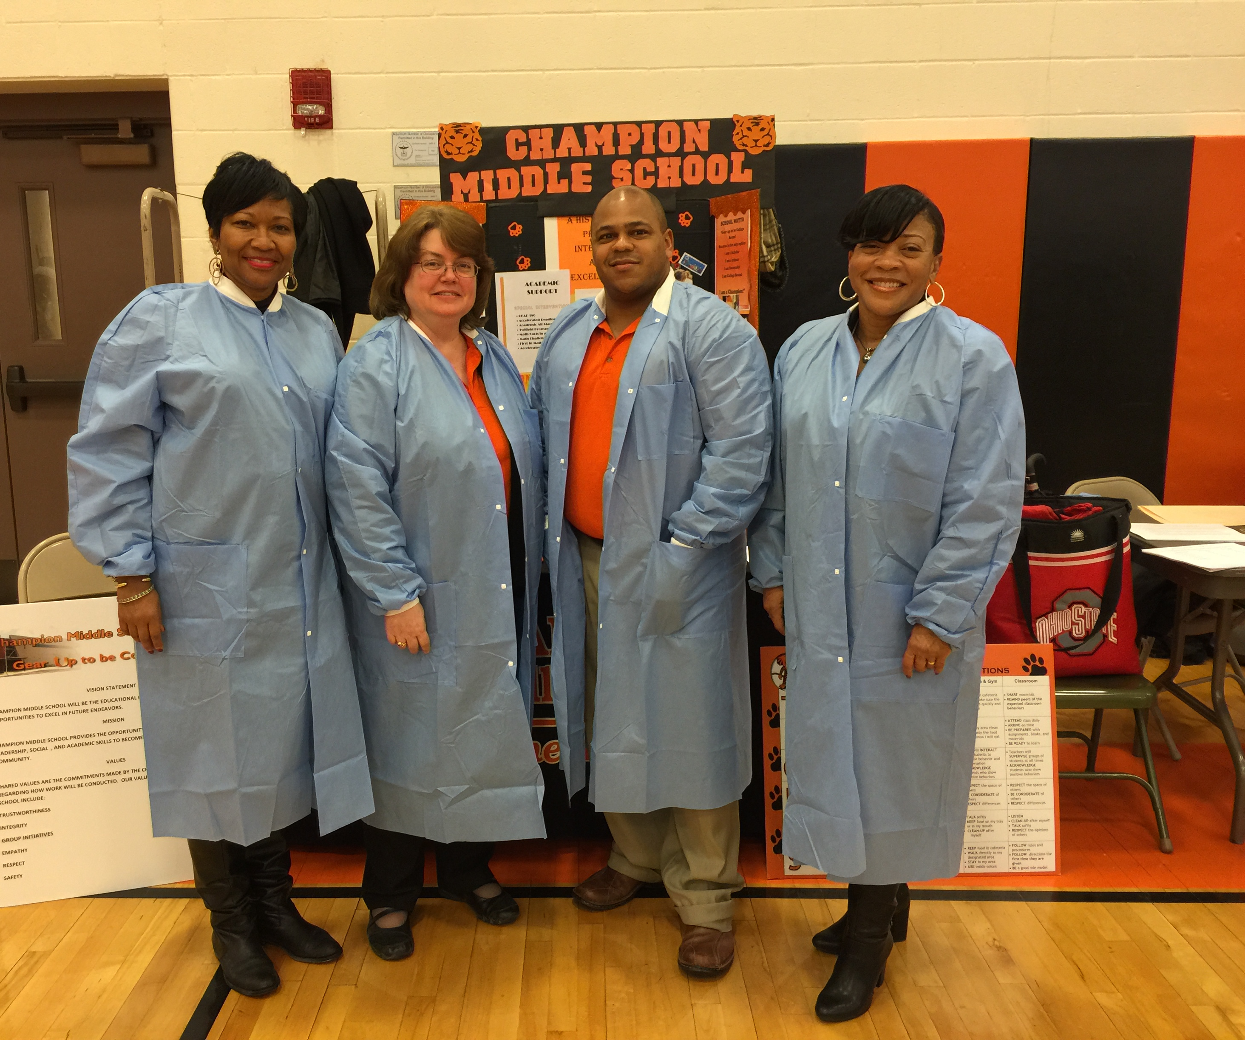
The Science of Healthy Living is a Lifestyle at Champion HSA.
Reaching A Rich And Full Life
Mentel Health Implementaions
I Bet I Tell: A Bully Free Protocol
Nationwide Children’s Behavoir Health –In School
Trauma Informed Practices : Franklin County Family & Children’s First Council – Staff & Students
Safer Together – Safety School wide
Mindfulness Space
Promoting Healthy Family Activities

Slide 4
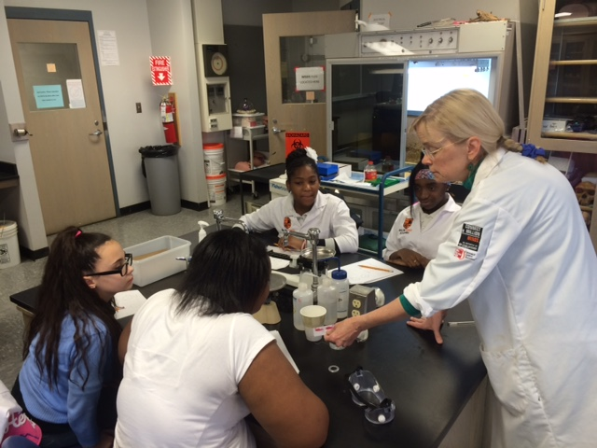
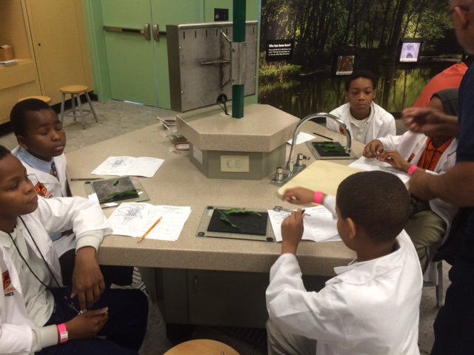
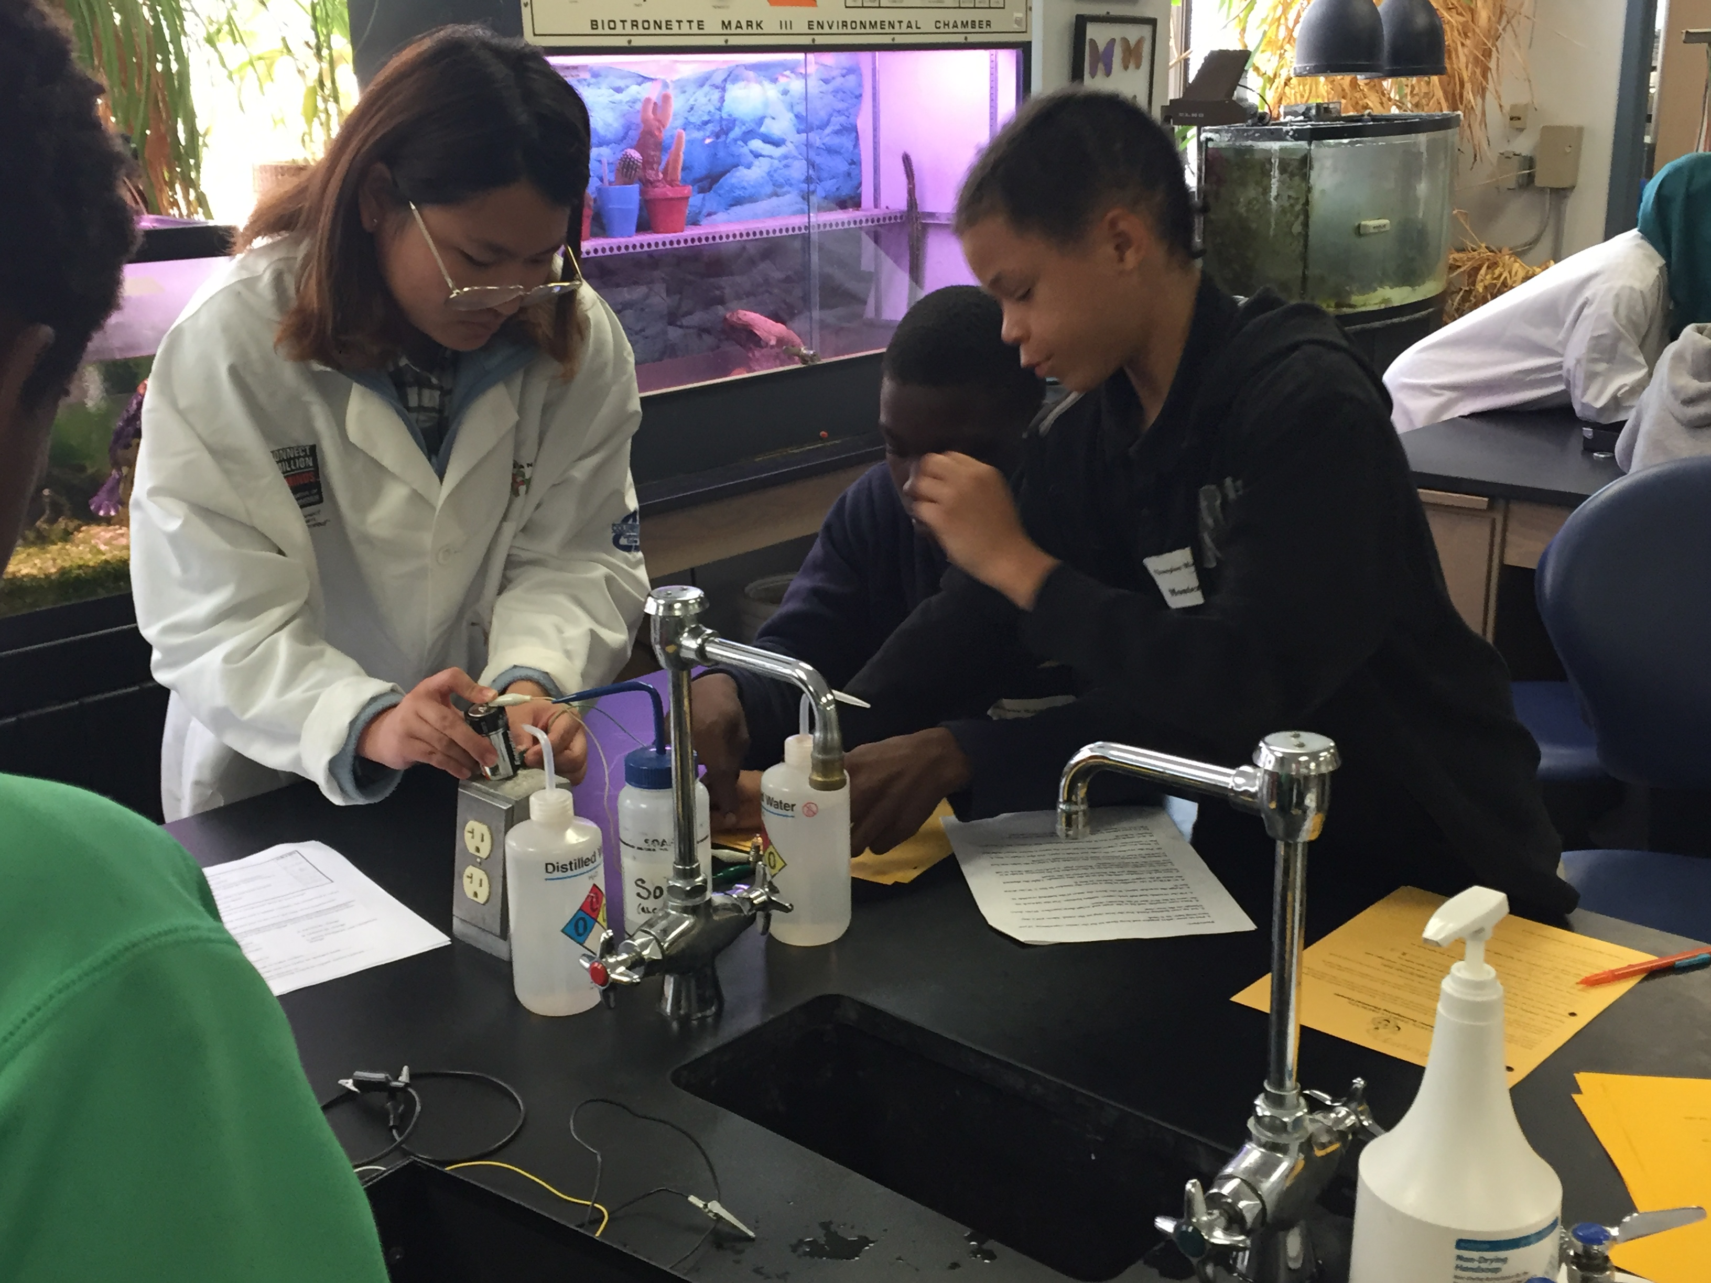
Health Science Curriculum

Slide 5
Curriculum Integration on a continuum
COSI Museum Visits : Targeted Experences
COSI Wheels Topic Targeted Whole School
Ohio State Research Day
Columbus State Community Collage : Fantastic Friday Experience
  Anatomy, Chemistry, Biochemistry , Environmental Science
  Forensic Science, Geology , Microbiology, Physics, Physiology, Zoology

Slide 6
Curriculum Integration on a Continuum
CPR Training and Cerification for Students and Staff
Healthy Eating & Nutrition
American Heart Association : Teaching Garden ( Healthy Food Farm to Table)
Local Matters – Food Education , Food Access, Food Advocacy
Food Consumption, and Healthful eating habits
The Community Classroom
Careers in Health & Science

